Slide 1
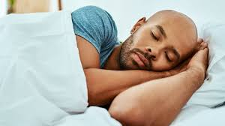
Are you getting enough sleep?

Slide 2

Tell Story about experiment
I'm gonna talk about "Is getting enough sleep important"?
I'm gonna tell a story about an experiment of sleep. Gerender was a high school student in the United States. He designed an experiment; Geneder stayed awake for 264 hours and 12 minutes(equivalent to 11 days).
After 24 hours, Gerender couldn’t read magazines and watch TV well.
After 4 days, he spoke difficulty so others couldn’t understand his words well.
After 10 days, while Gerender was passing a counting test, he stopped because he couldn’t remember what he was doing.
When the experiment finished, he went to bed and slept for 14 hours and 45 minutes, and on the second night, he slept for 12 hours.
Scientists found out if you don't get enough sleep, you get sick. I think It's interesting, there is a fantastic record in the Guinness Book. Western from the US stayed awake for 449 hours equivalent to 18 days and 17 hours.

Slide 3

Period of Sleep
There are five stages to sleeping
Stage one: falling sleep(to start to sleep)
Stage two: light sleep(your muscles relax, your temperature of body decreases)
Stage Three: deep sleep
Stage four & five: at this stage, we see dreams.
These stages take one and half hours and after stage five, we come back to stage one and start these stages again.

Slide 4
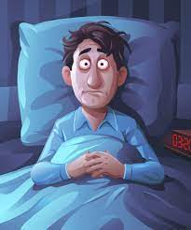
Disadvantages Of sleep
If you don’t get enough sleep, You’ll :
1- gain weight. (type 1)
2- get sick. (type 1)
3- not focus well. (type 1)
If you don’t get enough sleep, you’re always tired. (type 0)

Slide 5

I should give you some advice
You should go to sleep soon:
If you want to become successful.
If you want to have a lot of energy.
If you want to fit your body.
Finally
If you love yourself, you go to sleep soon.

Slide 6
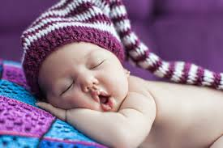



How much we need sleep
Babies: 9 to 11 hours
Teenagers: 8 to 10 hours
Youths: 7 to 9 hours
Adults: 7 to 8 hours
Elderlies: 7 to 8 hours

Slide 7
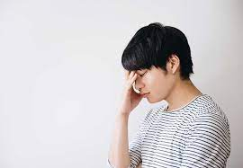
I wish I started with this question
Why do we need to go to sleep?
Sleeping :
1- Give energy to your body and brain.
2- Causes muscles repair.
3- Helps fight diseases.
4- Helps your brain to process faster.

Slide 8

What are the best ways to sleep better?
You should :
1- Never use your mobile at least one hour before going to bed.
2- Read books and magazines before sleeping because it helps you to sleep soon.
3- Have comfortable and standard matters for sleep.

Slide 9

Finish
Have a good day

